Slide 1




OS Rendering Service Made Parallel with
Out-of-Order Execution and In-Order Commit
Yuanpei Wu, Dong Du, Chao Xu, Yubin Xia, Yang Yu, Ming Fu, Binyu Zang, Haibo Chen
IPADS, Shanghai Jiao Tong University
Fields Lab, Huawei Central Software Institute
Notes:
Hello, everyone!
I am Yuanpei Wu.
It’s my pleasure to introduce our work “OS Rendering Service Made Parallel with Out-of-Order Execution and In-Order Commit”.
This is a joint work by IPADS, Shanghai Jiao Tong University, and Fields Lab, Huawei Central Software Institute.

Slide 2





Smart-Device Graphics
OS Rendering Service powers the visually stunning graphical user interfaces.
Notes:
Smart devices like smartphones, pads, laptops, etc., have become an important part of our daily life.
and the OS rendering service behind powers such visually stunning graphical user interfaces.

Slide 3
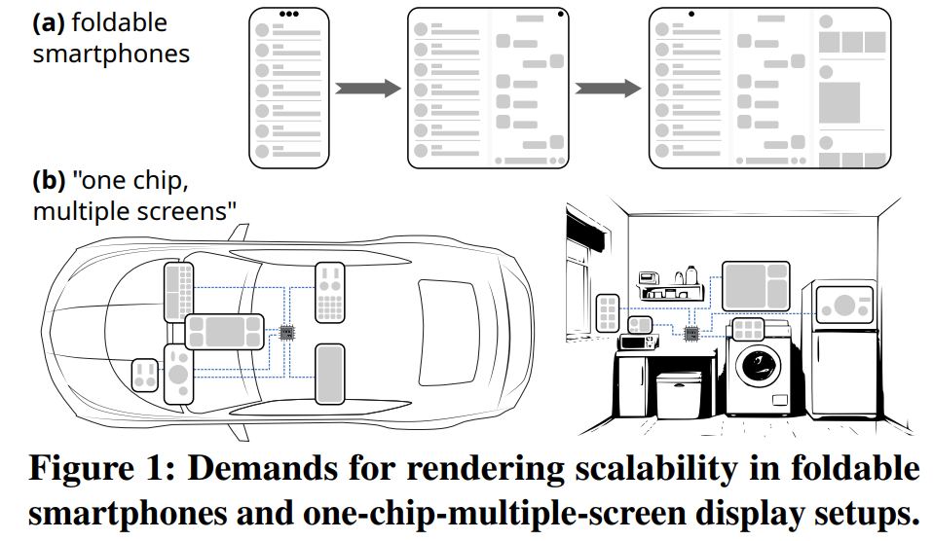
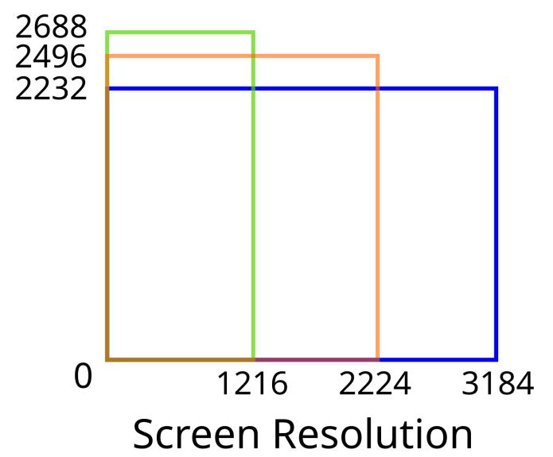
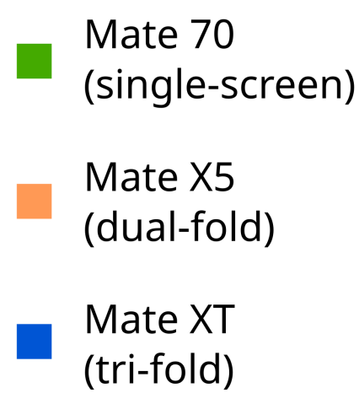
Demands for Rendering Scalability
Recent foldable smartphones and one-chip-multiple-screen setups significantly amplify the rendering workload and demand scalable rendering.
E.g., while the Huawei Mate 70 (single-screen), X5 (dual-fold), and XT (tri-fold) use similar chipsets, the latter two need to render 70% and 117% more pixels per frame.
Notes:
But the landscape of smart devices is changing rapidly. The recent wave of foldable smartphones, foldable laptops, and one-chip-multi-screen setups in cars and smart homes dramatically amplifies the rendering workload. For example, a tri-fold phone, often using a chipset similar to its single-screen counterpart, need to render 117% more pixels per frame. This creates an enormous demand for rendering scalability

Slide 4
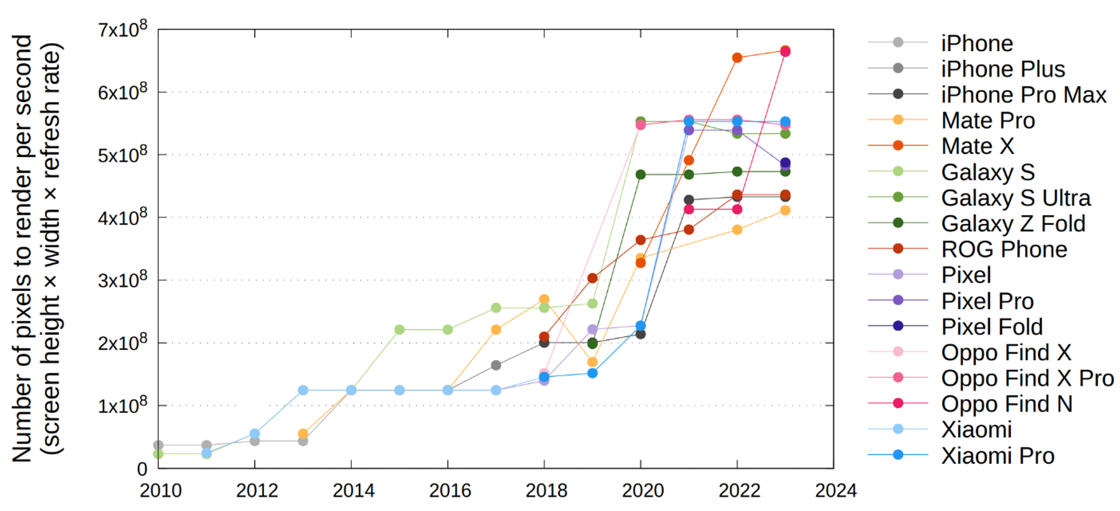
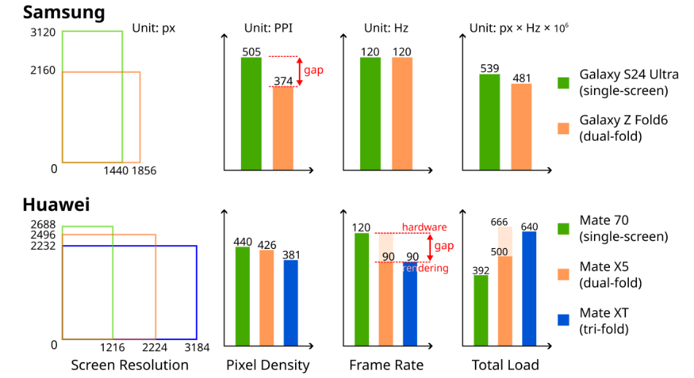
Rendering Scalability: A Continuous Trend
Displays are continuously evolving to become more immersive (with larger screen areas), clearer (with higher pixel densities), and smoother (with higher frame rates).
However, performance limits often force trade-offs and compromises — e.g., lower pixel densities or frame rates on foldable smartphones.
[1]
[1] Yuanpei Wu et al. D-VSync: Decoupled Rendering and Displaying for Smartphone Graphics. ASPLOS 2025.
Notes:
And this demand is continuous. Displays are constantly evolving to become more immersive with larger screen areas, clearer with higher pixel densities, and smoother with higher frame rates. The figure on the left shows the number of pixels flagship smartphones need to render per second, since 2010.
However, the performance of the underlying rendering service often becomes a bottleneck. This compels manufacturers to make difficult trade-offs. As shown on the right, some manufacturers reduce pixel density on their foldables, sacrificing the definition, and some lower the frame rate from 120Hz to 90Hz, impacting the smoothness.

Slide 5
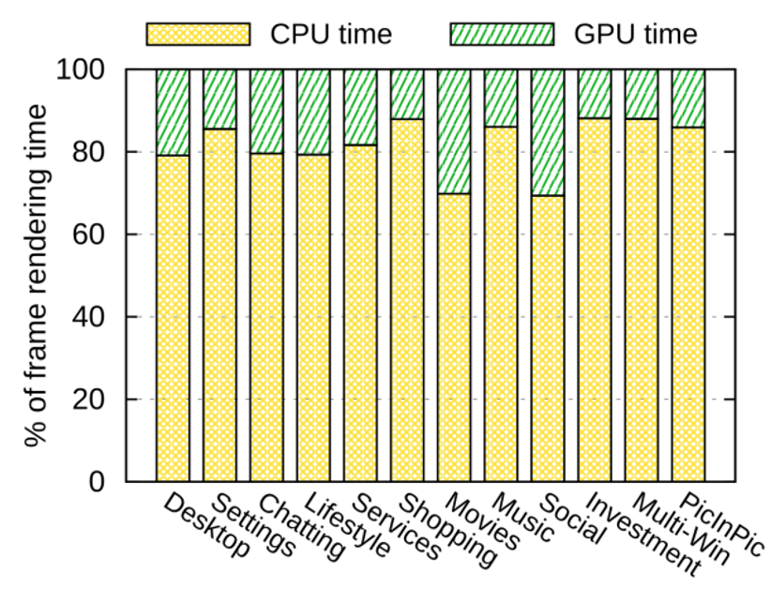
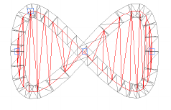
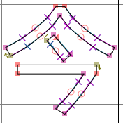
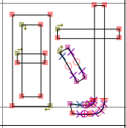
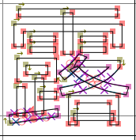
Observation-1: CPU bottlenecks OS 2D rendering
In 2D rendering, CPU accounts for 82% of the frame rendering time. As GPU and CPU run asynchronously, CPU is the performance bottleneck that impacts frame rate.
Tessellation & Triangulation
Glyph (Text) Rasterization
Notes:
So, what is the root cause of this bottleneck? We made two observations. First, CPU bottlenecks OS 2D rendering.
We analyzed various common smartphone scenarios, on average, CPU accounts for 82% of the frame rendering time.
The GPU's work is much shorter and can run asynchronously with CPU, so the overall frame rate is dictated by the CPU rendering time, that involves computationally intensive tessellation and triangulation, glyph rasterization, and other GPU object preparation.

Slide 6
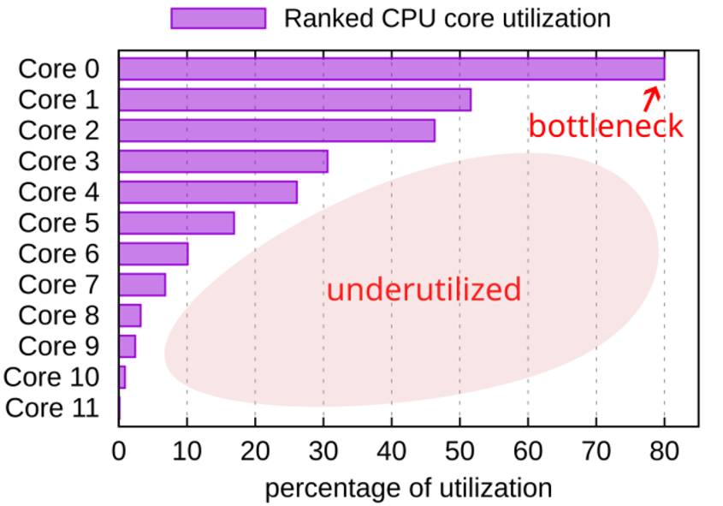
Observation-2: limited CPU multi-core utilization
Current state-of-the-art rendering procedure follows a fixed-thread sequential model, restricting the CPU multi-core utilization.
Render thread monopolizes 80% single-core utilization
While most cores (9 out of 12) are idle and underutilized
Notes:
Given that the CPU is the bottleneck, the obvious solution seems to be using more CPU cores. But this leads to our second observation: multi-core utilization is severely limited in the current rendering service.
This chart shows the CPU core utilization on a 12-core chipset during rendering. One core, running the render thread, is almost saturated. Meanwhile, most of the other cores are either idle or significantly underutilized. The current, predominantly sequential rendering model fundamentally prevents the system from taking advantage of the powerful multi-core processors available in modern chipsets.

Slide 7
We argue that
The next-generation rendering service should adopt a parallel architecture to address the scalable rendering demands.
Notes:
Based on the two observations, we argue that the next-generation rendering service should adopt a parallel architecture to address the scalable rendering demands, particularly as Moore's Law slows down, which restricts single-core performance.

Slide 8
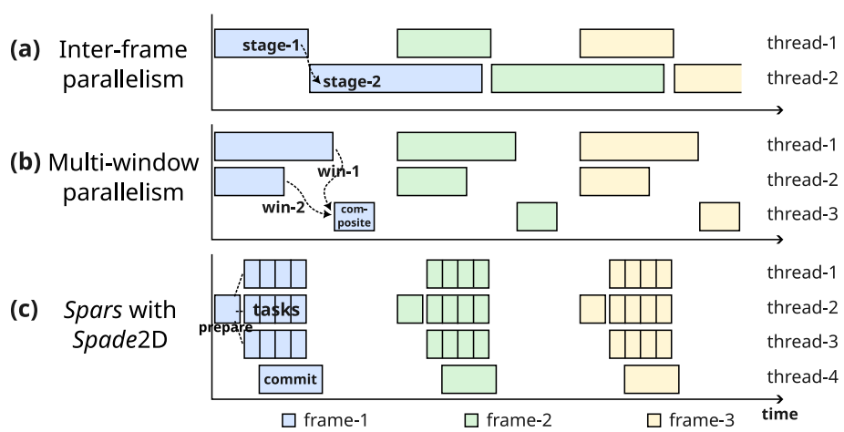
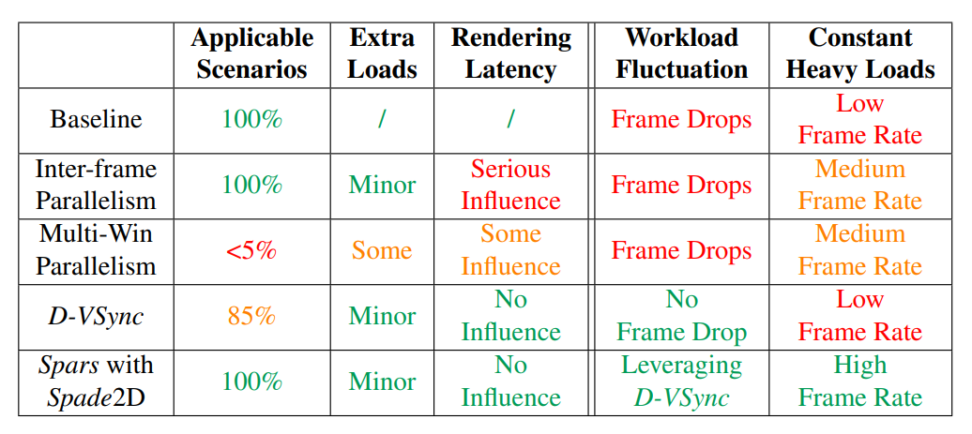
State-of-the-art Parallelization Efforts
Inter-frame parallelism and multi-window parallelism do not scale.
Inter-frame: span at most 2~3 threads, with load imbalance and more latency.
Multi-window: windowing abstraction required for parallelization, with load imbalance, extra memory, and composition costs.
[1]
[1] Yuanpei Wu et al. D-VSync: Decoupled Rendering and Displaying for Smartphone Graphics. ASPLOS 2025.
Notes:
There have been some prior efforts at parallelization, such as inter-frame parallelism where different stages of consecutive frames are pipelined across a few threads, and multi-window parallelism where different windows are rendered in different threads for later window composition.
However, these coarse-grained methods do not scale.
Inter-frame parallelism can span at most 2 to 3 threads with load imbalance and introduce more latency,
While multi-window parallelism has applicability limitations, as usually a main app with a single window occupies the entire workload. It also has extra memory and composition costs.
We wish to enable much finer-grained parallelism within a single frame, utilize more CPU cores, and deliver high frame rates even under constant heavy loads.

Slide 9
Background
Notes:
Before we dive into our solution, let's quickly review how a typical OS rendering service works in iOS or OpenHarmony. This will help clarify the specific challenges we need to solve.

Slide 10
Background: OS Rendering Service
Rendering service, as an OS service, renders the screen content in a unified manner.
Native Application
IPC
Rendering
Service
Display
Native Application
Native Application
Notes:
Rendering service, as an OS system service, renders the screen content synchronized from different applications in a unified manner.

Slide 11
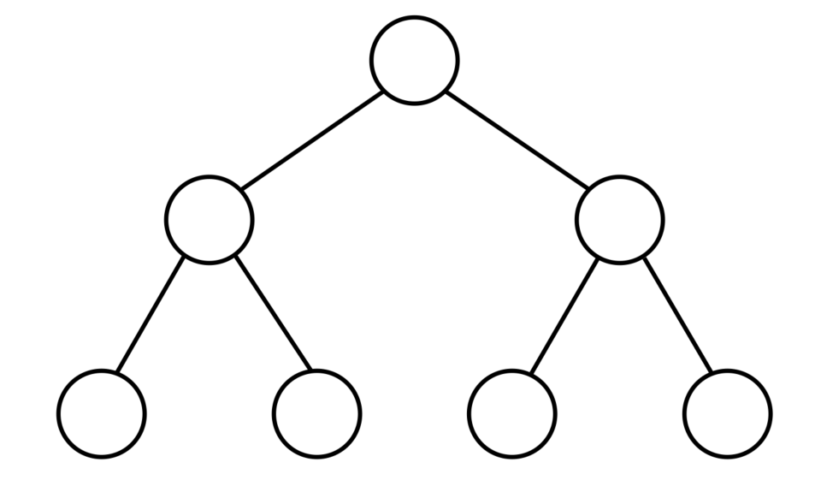
Background: Unified Render Tree
The render tree in the rendering service manages all the drawing information on the screen. Specifically, each render node contains the draw commands of a component.
Rendering
Service
Render Tree
Render Node
Notes:
At the heart of the service is a unified render tree. It manages all the drawing information on the screen. Specifically, each render node may contain some draw commands.

Slide 12





Background: Draw Command
Native applications synchronize draw commands to the rendering service for rendering.
Native Application
Rendering
Service
IPC
Draw Command
Notes:
Native applications synchronize these draw commands to the rendering service, which populate this tree. For example, the app here shows a blue card represented by the subtree with three render nodes and four draw commands.

Slide 13
Background: Relative Information
Each render node only contains the relative information (R) with respect to its parent, such as the relative transform matrix (encoding translation, scaling, and rotation).
R
Relative Information
c
R
c
c
R
Notes:
A key point to note is that each render node on the tree only contains the relative information (R) with respect to its parent, such as the relative transform matrix encoding translation, scaling, and rotation. This design ensures that modifying R of any node efficiently updates the entire subtree — for example, moving its position.

Slide 14



Background: Drawing Order
Each render node has its children sorted based on the drawing order, from back to front. Note that node drawing is not always commutative due to possible overlapping.
R
Expected Result:
c
R
c
c
R
Overlapping Relations
Notes:
Also, it should be pointed out that the drawing order must be respected for correctness. Node drawing is not always commutative due to possible overlapping. For example, the blue card must be rendered before the red circle and the red X. In the render tree, each render node has its children sorted based on the drawing order, from back to front.

Slide 15
Background: Depth-First Traversal
A sequential depth-first traversal of the tree implicitly enforces the drawing order and invokes the 2D engine to convert a stack of relative information into absolute states.
1
R
c
2
5
R
c
c
R
3
4
6
7
Notes:
Thus, to render a frame, the system performs a sequential Depth-First Traversal of the tree that implicitly enforces the drawing order and invokes the underlying 2D engine to convert a stack of relative information into absolute states.

Slide 16



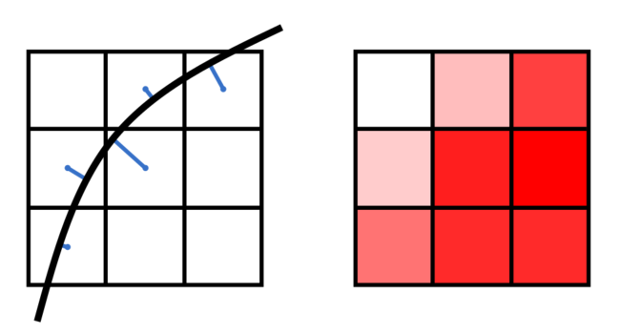
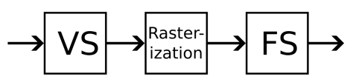
Background: 2D Engine
The 2D engine translates the parameters of the draw commands into GPU objects like meshes, textures, and pipelines, which are later sent to the GPU for rasterization.
Circle
Draw Cmd
Rasterized Pixels
GPU Objects
2D Engine
radius: 3.0
transform: [ ]
style: fill
color: red
mesh:
shader:
pipeline:
Notes:
As the tree is traversed, each abstract draw command is translated by the 2D Engine into concrete GPU objects like meshes, shaders, and pipelines, which are later sent to the GPU for pixel rasterization. This translation is the CPU-intensive work we identified earlier.

Slide 17
Background: Stateful Interface
Current 2D engines utilize stateful interfaces, where states can be kept internally, so new draw commands can rely on past draw commands.
Circle
Draw Cmd
Rasterized Pixels
GPU Objects
2D Engine
radius: 3.0
transform: [ ]
style: fill
color: red
mesh:
shader:
Stateful
Interface
Stateless
Interface
pipeline:
Notes:
While Vulkan exposes a stateless interface for parallelization, current 2D engines utilize stateful APIs, where states are kept internally in the 2D engine, so new draw commands can rely on past draw commands.

Slide 18
Parallelization Challenges
A scalable OS rendering service with fine-grained parallelization faces 3 challenges:
C1: State
Dependency
C2: Drawing Order Dependency
C3: Interface Dependency
Parallelization necessitates complete and absolute states for each rendering task, while each node in the render tree stores only the relative information to its parent, requiring a depth-first traversal.
Parallelization must explicitly maintain overlapping relations for drawing-order correctness. When two graphics primitives overlap, the background must always be drawn before the foreground.
Parallelization has stateless interface, while current 2D engines utilize a stateful API (e.g., Skia Canvas) for custom-rendering applications and internal stateful optimizations like command batching.
Notes:
To summarize, designing a scalable OS rendering service with fine-grained parallelization faces 3 key challenges.
点击
First, State Dependency: Parallel tasks need complete and absolute states. But the render tree only stores relative information, which seems to demand a sequential traversal.
点击
Second, Drawing Order Dependency: during rendering, we must respect the overlapping relations. A parallel execution could easily break the required drawing order.
点击
Third, Interface Dependency: Parallelization is inherently stateless, while current 2D engines utilize a stateful API for custom-rendering applications and internal stateful optimizations like command batching. A new parallel model must maintain compatibility as well.

Slide 19
Insight: Out-of-Order Execution with In-Order Commit
Fetch
Modern CPUs use out-of-order execution with in-order commit:
Instruction dependencies are analyzed to identify which ones can run in parallel.
Independent instructions are dispatched to available units (e.g., ALUs, FPUs) out of order.
After execution, results wait in the Reorder Buffer (ROB) until all earlier instructions have been committed in program order.
Decode
Rename/Allocate/Commit
Reorder Buffer (ROB)
Out-of-Order Execution
& In-Order Commit
Reservation Station (RS)
ALU
ALU
FPU
LSU
Memory Order Buffer (MOB)
L1 Data Cache
Notes:
To solve these challenges, we drew inspiration from a classic, powerful concept in computer architecture: out-of-order execution with in-order commit.
Modern CPUs achieve incredible performance by analyzing instruction dependencies, executing independent instructions in parallel and out of order, and then using a reorder buffer to commit the results in the original program order to ensure correctness.

Slide 20
Insight: Out-of-Order Execution with In-Order Commit
Fetch
We observed the analogy:
Draw command → CPU instruction
CPU multi-core → ALU/FPU/LSU
State dependency → operand dep.
Drawing order → program order
Why not adopt a similar strategy?
In-Order preparation
Out-of-Order execution
In-Order commit
Decode
Rename/Allocate/Commit
Reorder Buffer (ROB)
Out-of-Order Execution
& In-Order Commit
Reservation Station (RS)
ALU
ALU
FPU
LSU
Memory Order Buffer (MOB)
L1 Data Cache
Notes:
We saw a clear analogy. A draw command is like a CPU instruction. The multiple CPU cores are like the various execution units. State dependency is like an operand dependency, and the drawing order is the program order.
So, our key insight is to adopt this same winning strategy: In-Order preparation, Out-of-Order execution, and In-Order commit.

Slide 21

Spars: A Scalable and Parallel OS Rendering Service
Notes:
This insight led us to the design of Spars, a new Scalable and Parallel OS Rendering Service.

Slide 22
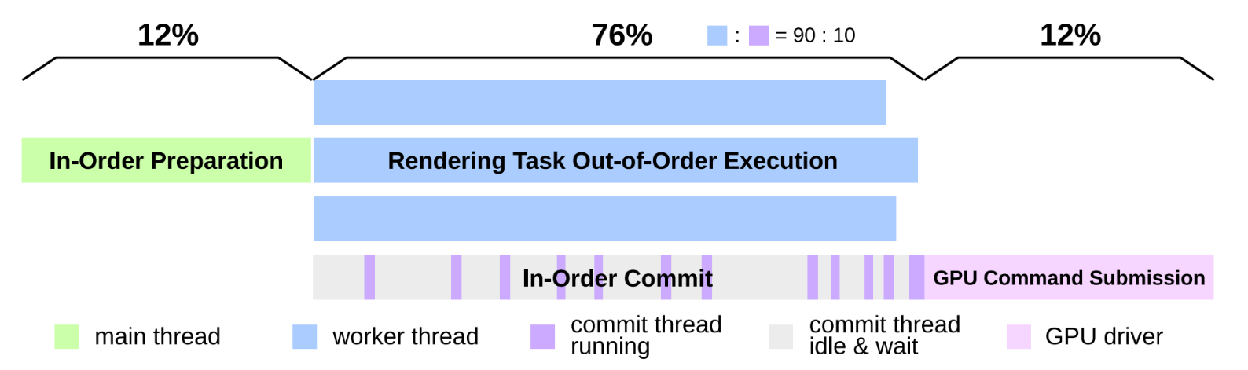
The Three-Stage Design of Spars
In-order preparation (main thread): the render tree is traversed once in a depth-first manner to prepare self-contained rendering tasks (put into a single-producer multi-consumer SPMC pool) and their overlapping relations.
Out-of-order execution (worker threads): execute rendering tasks retrieved from the SPMC pool. Each task can be independently and OoO executed. The generated GPU objects are packed and put into a MPSC pool.
In-order commit (commit thread): bind the objects into the GPU command in order.
Notes:
Spars redesigns the rendering procedure into three distinct stages, as this timeline illustrates.
First, on the main thread, we have a fast, lightweight In-Order Preparation stage.
Second, the bulk of the work—about 76% of the total load—happens in the Out-of-Order Execution stage, where a pool of worker threads executes rendering tasks in parallel.
Finally, a dedicated commit thread performs the In-Order Commit, gathering the results and ensuring rendering correctness.

Slide 23
Revisit State Dependency
State dependency (C1): current nodes only store relative information R.
1
R21
R51
c
2
5
R32
c
c
R42
R65
R75
3
4
6
7
Notes:
Let's see how this design addresses our first challenge: State Dependency, where nodes only store relative information.

Slide 24
In-Order Preparation: a dry run for complete states
To tackle C1, during preparation, Spars traverses the render tree once in a dry run (without doing any rendering), and records the absolute information A — relative to the screen coordinates or the absolute zero.
1
R21
R51
c
A2
2
5
R32
c
c
R42
R65
R75
A3
3
A4
4
A6
6
A7
7
Notes:
During the in-order preparation, Spars traverses the render tree once in a dry run without doing any rendering. Spars calculates and records the absolute information A for each node, relative to the screen coordinates or the absolute zero. A is stored within the nodes that contain draw commands, and can be reused across frames, until an animation or interaction updates its value.

Slide 25
In-Order Preparation: generate self-contained tasks
Meanwhile, the draw commands with complete states are batched and encapsulated into self-contained rendering tasks, put into a single-producer multi-consumer (SPMC) pool.
1
R21
R51
c
A2
2
5
Rects
Task
Circles
Task
Glyphs
Task
Lines
Task
R32
c
c
R42
R65
R75
A3
3
A4
4
A6
A7
Self-Contained Task Pool
6
7
Notes:
With this absolute information, during the same traversal, Spars can now encapsulate truly self-contained rendering tasks. Each task can batch multiple draw commands if possible and has their complete states. These tasks are then put into a single-producer multi-consumer task pool, ready for the worker threads to consume in parallel.

Slide 26
Revisit Drawing Order Dependency
Drawing order dependency (C2): drawing order must be maintained for correctness.
1
R21
R51
c
A2
2
5
Rects
Task
Circles
Task
Glyphs
Task
Lines
Task
R32
c
c
R42
R65
R75
A3
3
A4
4
A6
A7
Self-Contained Task Pool
6
7
Notes:
Now for the second challenge: Drawing Order. How do we execute these tasks out-of-order but still get the final image correct?

Slide 27
In-Order Preparation: construct overlapping relations
To tackle C2, Spars chains the rendering tasks together for a naïve drawing order and manages their drawing regions through axis-aligned bounding boxes (AABBs) for each task. The chain is later synchronized to the commit thread from the main thread.
non-overlapping
Rects
Task
Circles
Task
Glyphs
Task
Lines
Task
overlapping
Self-Contained Task Pool
Overlapping Relations
Notes:
During the preparation stage, in addition to creating tasks, Spars also explicitly constructs their overlapping relations by chaining them together for a naïve drawing order and managing their drawing regions through axis-aligned bounding boxes for each task. The chain is later synchronized to the commit thread from the main thread.

Slide 28
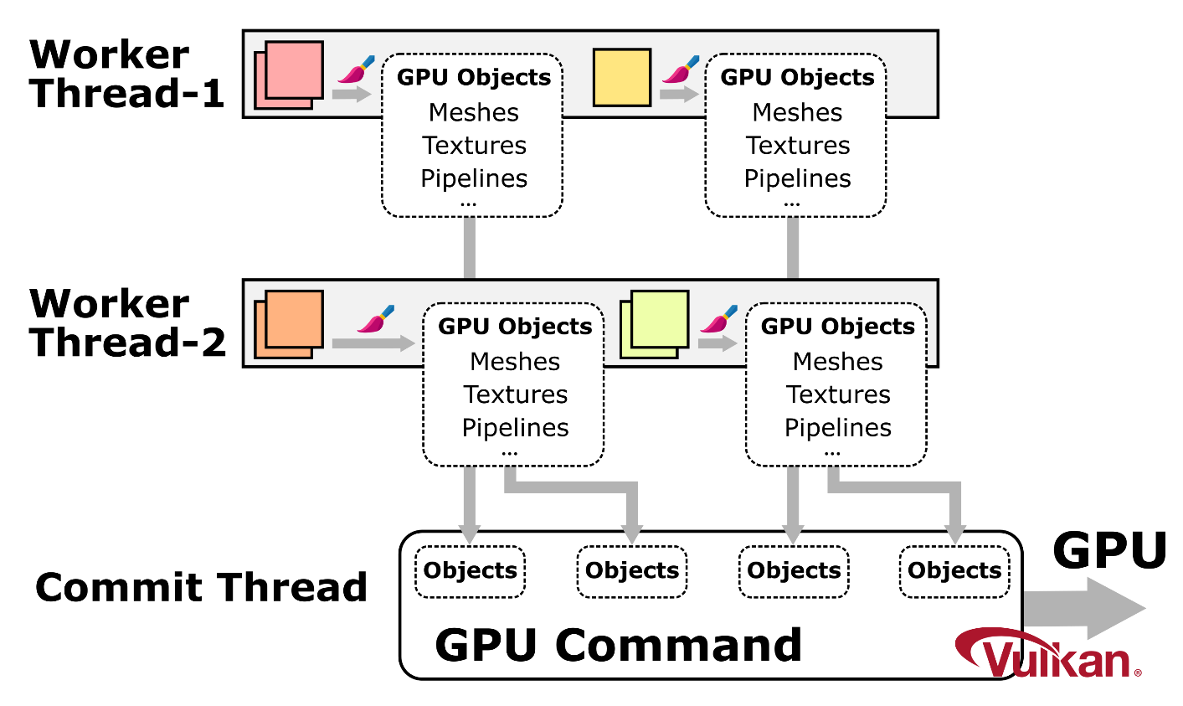
Out-of-Order Execution on multiple worker threads
The tasks are dispatched to multiple worker threads for out-of-order execution. As tasks are independent, any thread can process any task, using a novel 2D engine.
Rects
Task
Circles
Task
Glyphs
Task
Lines
Task
Self-Contained Task Pool
non-overlapping
overlapping
Overlapping Relations
Notes:
With self-contained tasks ready, we move to the execution stage. Worker threads simply pull tasks from the pool and execute them in parallel and out-of-order. Since they are independent, any thread can process any task with any order. The output is a set of GPU objects packed together and sent to the commit thread.

Slide 29
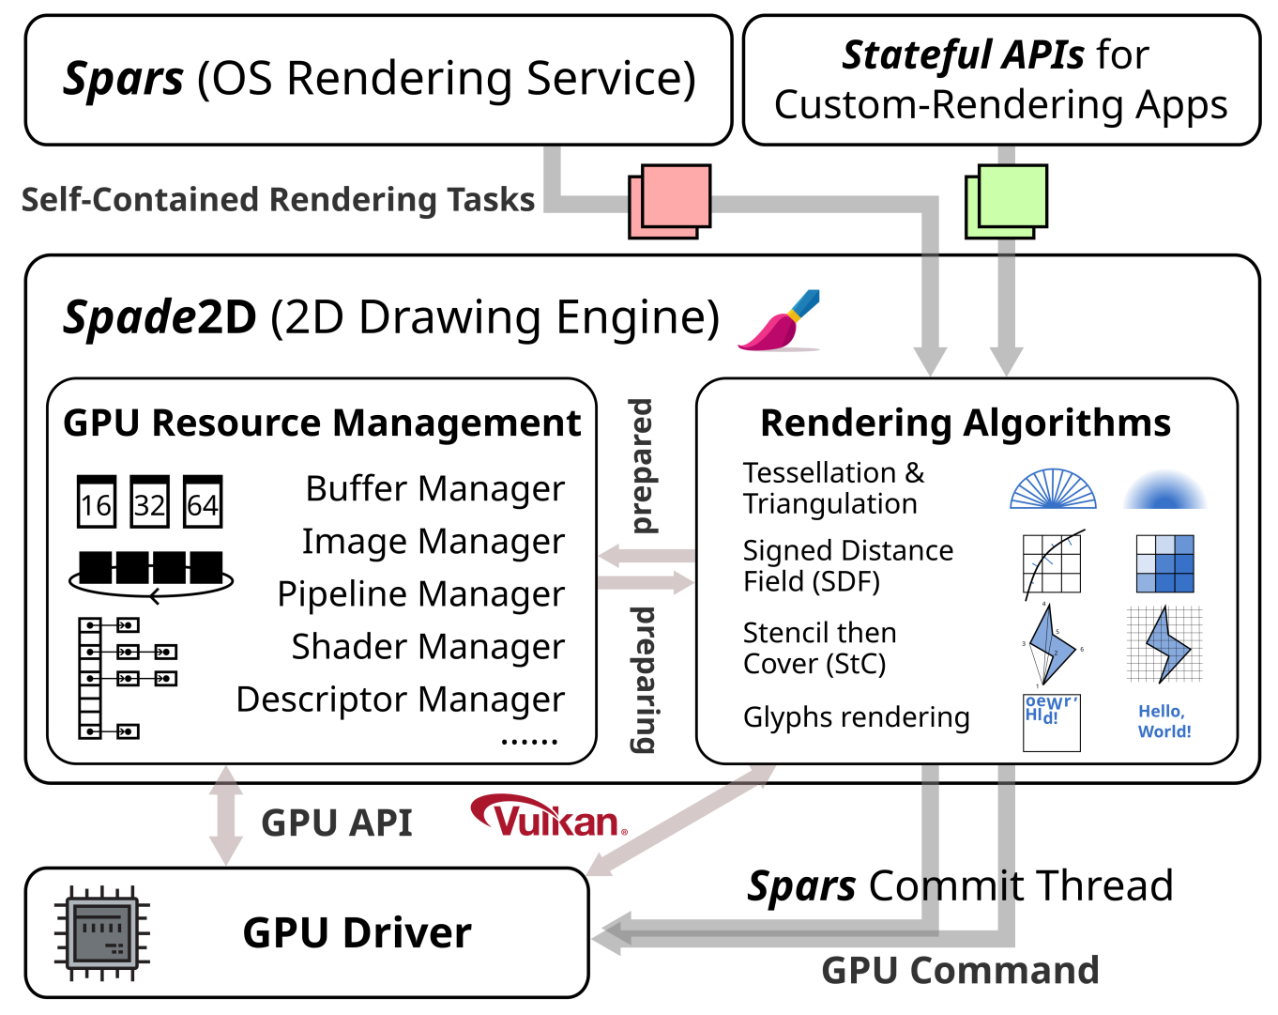

Out-of-Order Execution with a stateless 2D engine
Spade2D adopts stateless APIs and accepts inputs in the form of self-contained tasks. GPU resources in Spade2D are managed by thread-safe managers that prevent resource double creation.
Notes:
To support this, we built a new stateless 2D drawing engine named Spade2D. Spade2D accepts self-contained rendering tasks and provides thread-safe management of GPU resources like buffers and pipelines, which is crucial for conflict-free parallel execution. Please see our paper for the details.

Slide 30
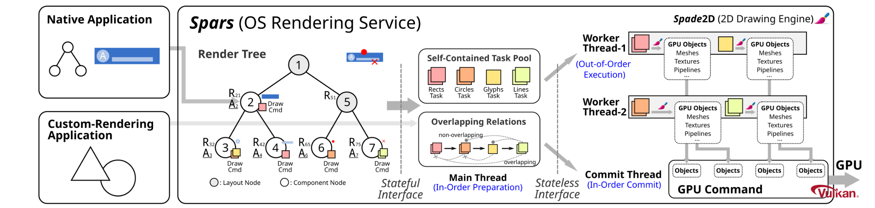
Revisit Interface Dependency
Interface dependency (C3): current rendering APIs for custom-rendering applications are stateful. 2D engines also rely on internal state-based optimizations.
Notes:
This brings us to our third challenge: Interface Dependency.

Slide 31
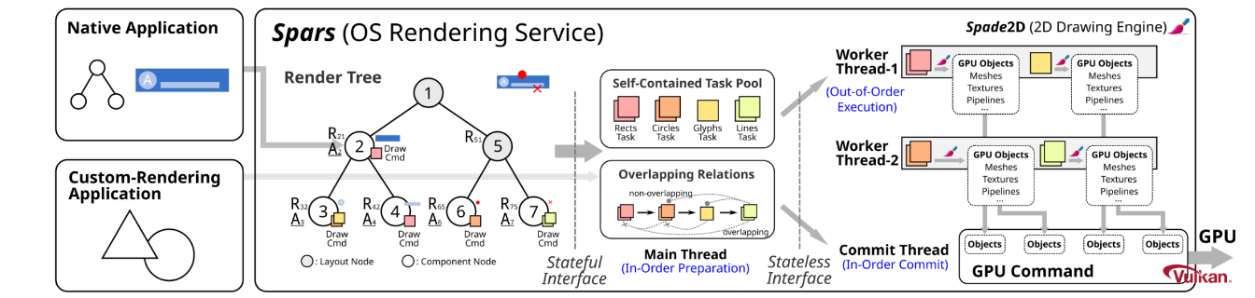
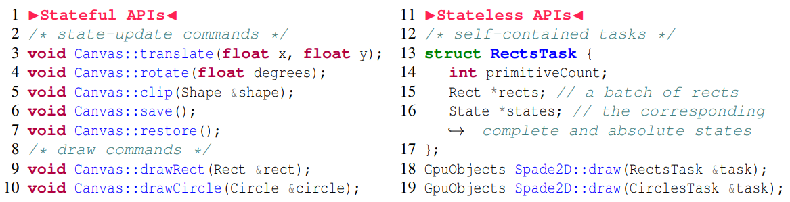
Out-of-Order Execution ensuring compatibility
To tackle C3, Spars decouples the rendering procedure into stateful and stateless phrases: the former maintains a consistent interface for custom-rendering applications and does state-based optimizations, while the underlying Spade2D engine is stateless.
Notes:
Spars solves this by decoupling the rendering procedure into two phrases. We provide a stateful API layer that is fully compatible with existing custom-rendering applications and state-based optimizations. Internally, this layer translates the familiar stateful commands into our self-contained, stateless tasks, which are then processed by Spade2D. This gives us both the compatibility and parallelism.

Slide 32
In-Order Commit based on overlapping relations
The commit thread checks if it is possible to commit (bind) the received completed task (GPU objects) into the GPU command, based on the task chain and AABBs — if the task is the current head or has no overlapping with the previous uncommitted tasks.
Notes:
Finally, the in-order commit thread receives completed tasks, namely, the generated GPU objects, from the workers.
Using the overlapping relations that the main thread generated earlier, it ensures that if two tasks overlap, the background task is always committed before the foreground task into the GPU command. This process is very lightweight and is almost entirely covered by the execution stage.

Slide 33
Evaluation
Notes:
Lastly, we present the evaluation.

Slide 34
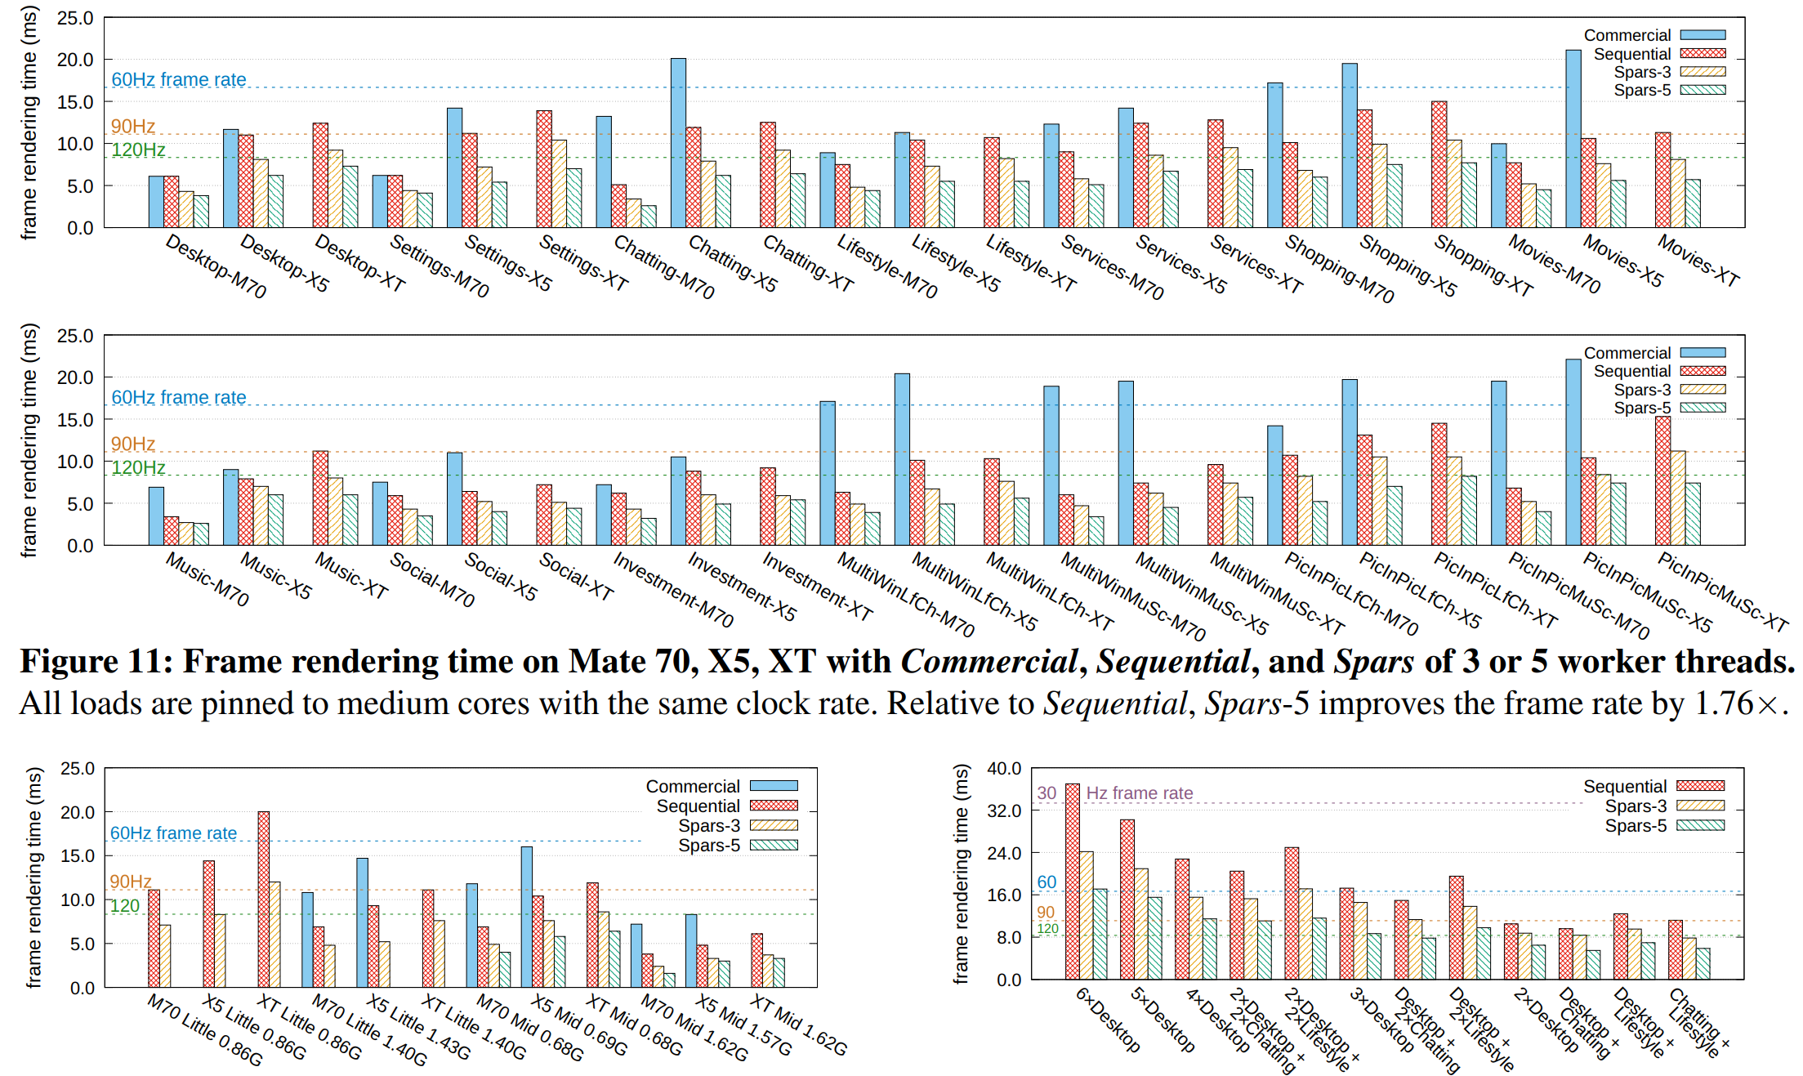
Frame rate improvement 1.76× ~ 1.91× with 5 workers
42 representative smartphone scenarios on Mate 70, X5, XT, and multi-screen configs.
Notes:
We implemented and evaluated Spars on a range of modern commercial smartphones, specifically, the single-screen Mate 70, dual-fold Mate X5, and tri-fold Mate XT, as well as multi-screen configurations.
The charts show the frame rendering time across 42 representative scenarios under different setups. Compared to our sequential baseline, Spars with 5 workers improves the frame rate by an average of one point seven six to one point nine one times, achieving a stable 120Hz in many scenarios where the baselines could not.

Slide 35
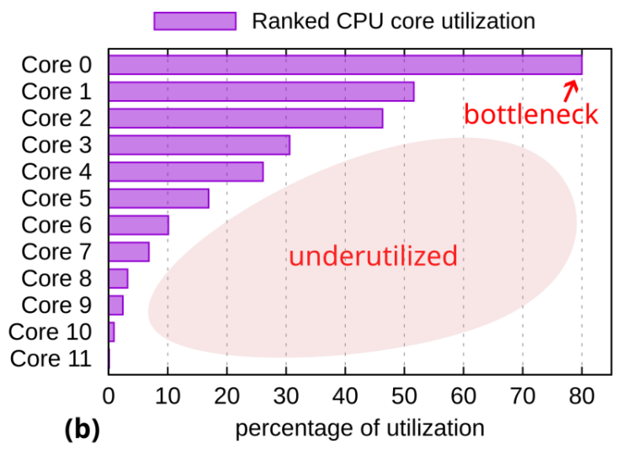
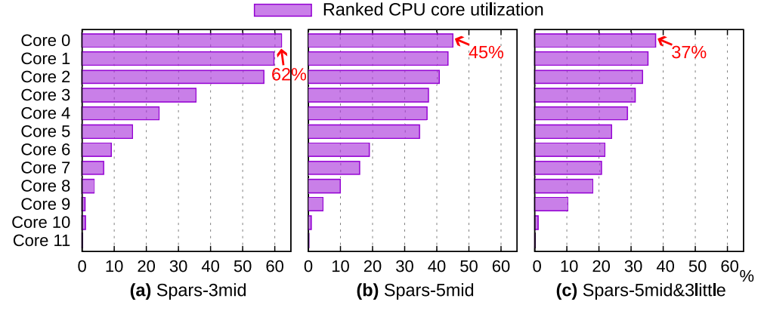
Multi-core CPU utilization is more balanced
Under the same frame rate, Spars optimizes the utilization of multi-core hardware in smart devices and ensures a more balanced workload across cores, preventing any single core from becoming the frame rate bottleneck.
vs.
Notes:
Spars achieves this by making much better use of the hardware. Here, you can see how the workload, which was bottlenecked on a single core in the baseline, is now much more balanced across multiple cores with Spars.

Slide 36
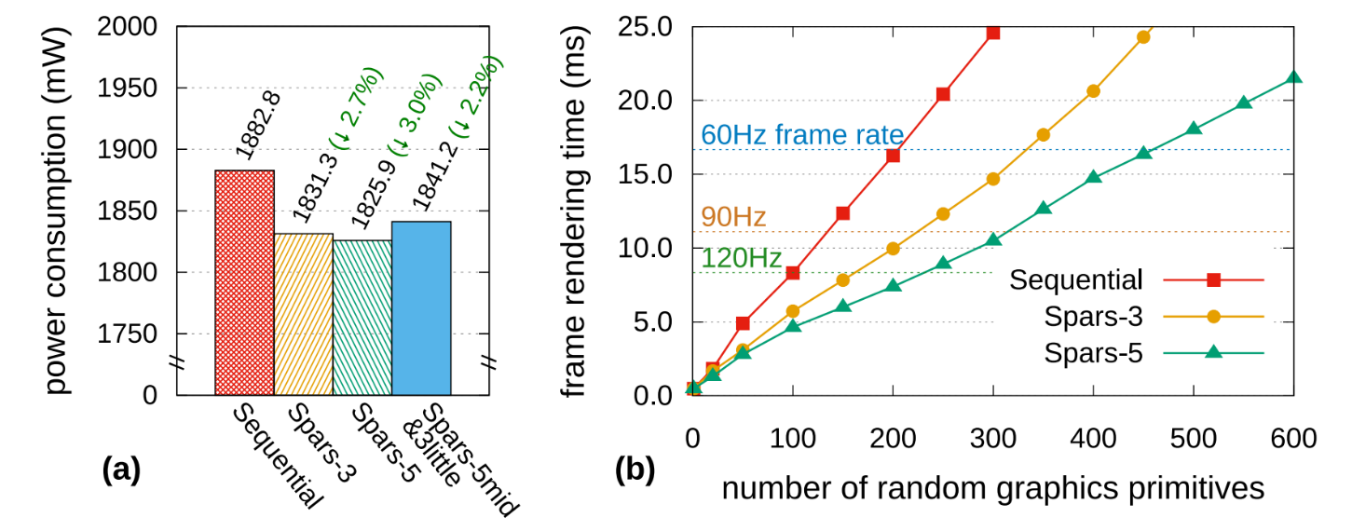
Power Consumption & Scalability of Rendering
Under the same stable frame rate, Spars can reduce (a) the power consumption by 3.0%, or increase (b) the number of graphics primitives, i.e., visual quality, by 2.31×.
Notes:
This efficiency translates into two key benefits.
First, under the same frame rate, Spars can reduce the device's total power consumption by 3.0%. This is because a balanced core utilization can make DVFS to apply a lower overall voltage and frequency, whereas rendering on a single core in the sequential baseline often forces the CPU to raise its frequency for frames to meet their display deadlines.
Alternatively, within the same time budget, Spars allows us to render 2.31 times as many graphics primitives, giving designers far more freedom to create richer and more appealing user interfaces.

Slide 37

Conclusion
We present Spars with Spade2D, a next-generation scalable and parallel OS rendering service & drawing engine for smart devices.
Spars untangles state dependency, drawing order dependency, and interface dependency, allowing out-of-order execution with in-order commit of self-contained rendering tasks.
Evaluations demonstrate that Spars substantially enhances frame rates on emerging foldable smartphones and multi-screen configurations, efficiently leveraging multiple CPU cores while reducing power consumption and scaling the number of graphics primitives.
Thanks!
Notes:
To conclude, we present Spars, a next-generation scalable and parallel OS rendering service. By drawing inspiration from out-of-order execution and in-order commit in CPUs, Spars untangles state dependency, drawing order dependency, and interface dependency.
We believe this design offers a clear path toward building scalable rendering systems for the future of smart devices.
Thank you. I'm now happy to take questions.

