Slide 1


D-VSync: Decoupled Rendering and Displaying For Smartphone Graphics
Yuanpei Wu, Dong Du, Chao Xu, Yubin Xia, Ming Fu, Binyu Zang, Haibo Chen
IPADS, Shanghai Jiao Tong University
Fields Lab, Huawei Central Software Institute
Notes:
Hello, everyone!
I am Yuanpei Wu.
It’s my pleasure to introduce our work “D-VSync: Decoupled Rendering and Displaying For Smartphone Graphics”.
This is a joint work by IPADS, Shanghai Jiao Tong University, and Fields Lab, Huawei Central Software Institute.

Slide 2
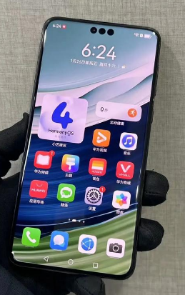
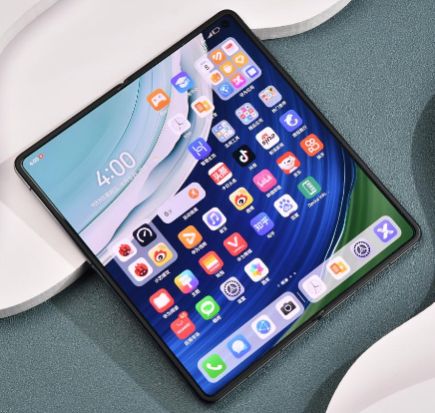

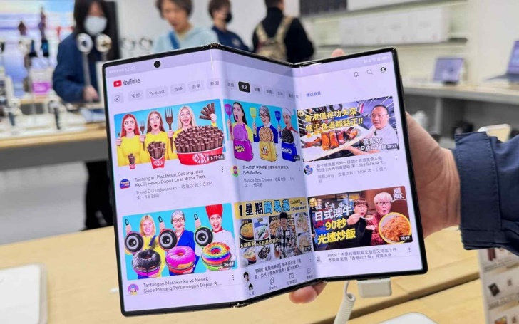

Smartphone Graphics
Notes:
Smartphones have become an important part of our daily life.
and the OS rendering architecture behind is a crucial sub-system that enables the display of stunning graphical user interfaces for both entertainment and productivity purposes.

Slide 3

Three-Layer OS Rendering Architecture
App 1
App 2
App 3
OS Rendering Service
Screen HAL
The OS rendering architecture consists of app processes, a rendering service, and the screen hardware abstraction layer (HAL).
Notes:
Here, we simplify OS rendering architecture into three layers:
app processes for handling application-specific logic,
an OS rendering service for doing the animation and rendering,
and the screen hardware abstraction layer for the final display of frames.

Slide 4
FIFO Queueing in OS Rendering Architecture
App 1
App 2
App 3
queue
Draw Commands
OS Rendering Service
queue
Frame Buffers
Screen HAL
Apps send draw commands to the rendering service for animation and rendering, which then sends the rendered frame buffers to the screen HAL for display. The communication follows a first-in-first-out (FIFO) queueing mechanism.
Notes:
App processes first send draw commands to the rendering service for animation and rendering,
and the rendering service then sends rendered frame buffers to the screen HAL for display.
The communication follows a first-in-first-out (FIFO) queueing mechanism, and each buffer of the queue is for one frame.

Slide 5
VSync Signals in OS Rendering Architecture
App 1
App 2
App 3
queue
Draw Commands
OS Rendering Service
VSync Signals
queue
Frame Buffers
Screen HAL
The three-stage rendering pipeline is synchronized through periodic screen Vertical Synchronization (VSync) signals (e.g., 8.33ms for a 120Hz screen).
Notes:
Thus, the rendering architecture forms a three-stage pipeline, and the stages are synchronized through periodic screen Vertical Synchronization signals.
For example, if the screen is 120Hz, then the VSync signal period is 8.33 milliseconds.
A runtime trace will make it clear.

Slide 6
Frame Display in OS Rendering Trace
Screen Displaying
Frame 1
Frame 2
Frame 3
Frame 4
Frame 5
Frame 6
VSync Signals
timeline
VSync period
In every VSync period (e.g., 8.33ms), the screen needs to display a new rendered frame.
Notes:
Here, the x-axis is the timeline. We can see that in every VSync period (namely, every 8.33ms), the screen needs to display a new rendered frame.

Slide 7
Stage Aligning in OS Rendering Trace
App UI Thread
Frame 3
Frame 4
Frame 5
Frame 6
… …
Triggered by VSync-app
Rendering Service
Frame 2
Frame 3
Frame 4
Frame 5
Frame 6
… …
Triggered by VSync-rs
Screen Displaying
Frame 1
Frame 2
Frame 3
Frame 4
Frame 5
Frame 6
VSync Signals
timeline
Software VSync signals trigger each stage of the pipeline: the stages are perfectly aligned, with the app logic first, then the rendering, and finally the frame display.
Notes:
If we add the App UI Thread and the rendering service into the trace, we can see that software VSync signals trigger each stage of the pipeline,
And the stages are perfectly aligned, with the app logic first, then the rendering, and finally the frame display.

Slide 8
Frame Drop in OS Rendering Trace
App UI Thread
Frame 3
Frame 4
Frame 5
Frame 6
… …
Rendering Service
Frame 2
Frame 3
Frame 4
Frame 5
Frame 6
… …
deadline miss
Screen Displaying
Frame 1
Frame 2
Frame 3
JANK
Frame 4
Frame 5
Frame 6
VSync Signals
timeline
If one stage misses the VSync deadline, the screen will have nothing to update in the next VSync period, producing a frame drop (jank), and users may experience a stutter.
Notes:
However, there is no guarantee that each stage can finish within its designated VSync period,
as the computational power for smartphones usually does not have much redundancy to tolerate workload fluctuations.
For example, if the frame 4 here runs longer than expected, and misses the VSync deadline,
then the screen will have nothing to update after frame 3, producing a frame drop, also known as a jank,
And users may experience a stutter.

Slide 9
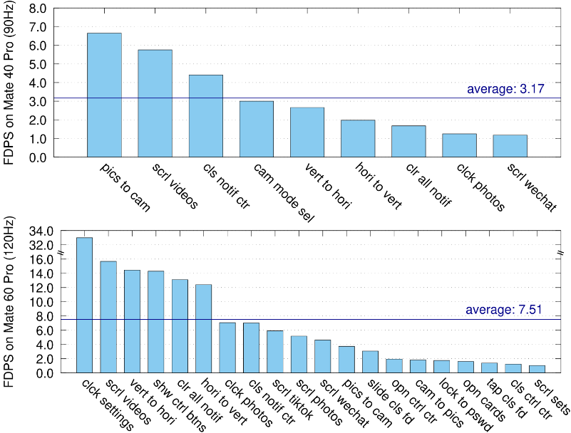
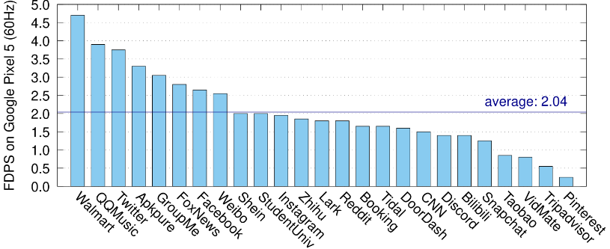
Frame Drops are Common in the Wild
Frame drops are common due to workload fluctuations
  Over 75 common OS use cases, 9 and 20 have frame drops on Mate 40 Pro (90Hz, OH 4.0) and Mate 60 Pro (120Hz, OH 4.0), respectively.
  The average frame drops per second (FDPS) can reach 7.51 and 8.42 for GLES and Vulkan backends, respectively, on Mate 60 Pro (120Hz, OH4.0).
  Many important cases like closing the notification center or clearing all notifications can only reach 95–105 FPS on the 120 Hz screen, causing noticeable stutters to users.
Notes:
Unfortunately, such frame drops are common in the wild due to workload fluctuations.
Over 75 common OS use cases we measured, 9 and 20 have frame drops on Mate 40 Pro and Mate 60 Pro with OpenHarmony 4.0.
The average frame drops per second can reach 7.51 and 8.42 for GLES and Vulkan backends on Mate 60 Pro.
Many important cases like closing the notification center or clearing all notifications can only reach 95–105 FPS on the 120 Hz screen, causing noticeable stutters to users.

Slide 10
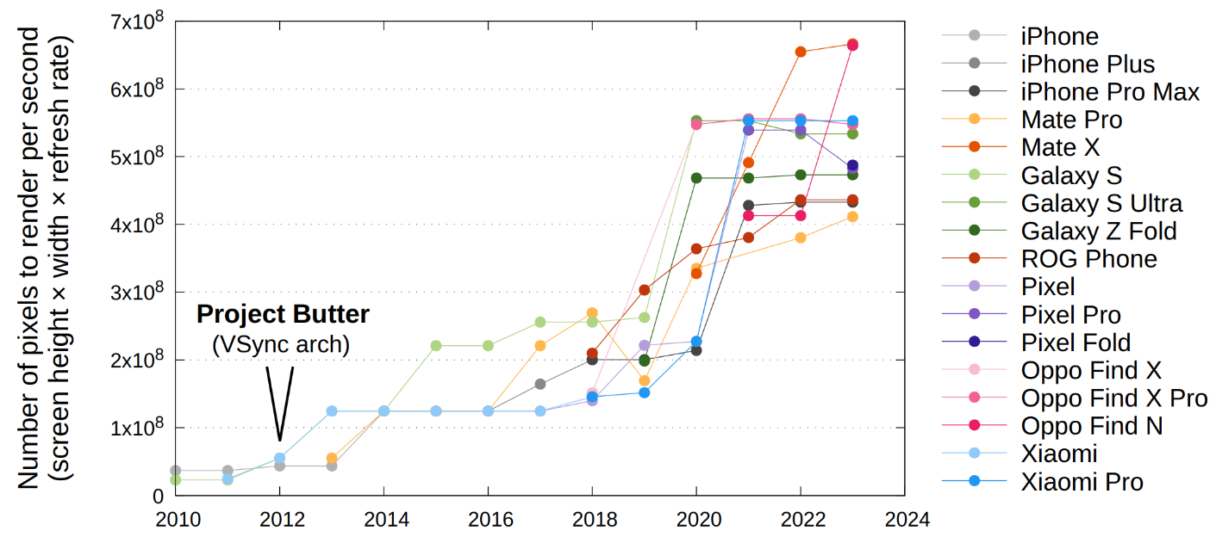
Trends in Rendering #1: Display Hardware
Smartphone vendors are integrating displays that are clearer (higher pixel density), smoother (higher refresh rate), and more immersive (larger screen size).
Trend in the number of pixels rendered per second by the rendering architecture. The number has increased about 25 times over the past one and a half decades.
Notes:
We attribute frame drops to two main reasons.
First, smartphone vendors are integrating displays that are clearer, smoother, and more immersive into their products.
That is, higher pixel density, higher refresh rates, and larger screen size in display hardware.
Thus, the number of pixels that the rendering architecture needs to render per second has increased about 25 times over the past one and a half decades.

Slide 11
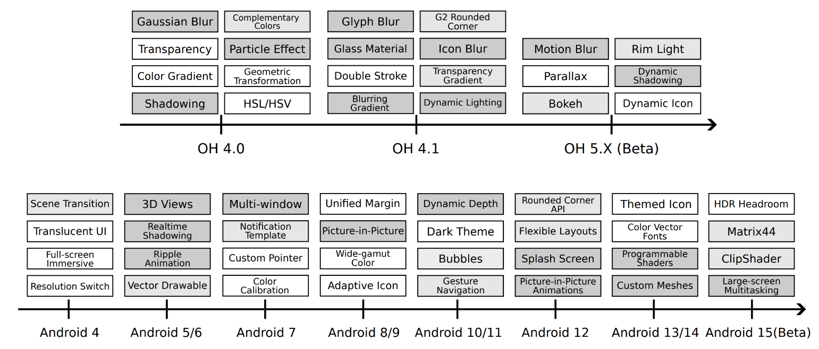
Trends in Rendering #2: Visual Effects
Real-world scenes involve different combinations of the visual effects and physics-based animations, making the rendering workloads fluctuating and unpredictable
Trend in the increasing number of graphics features supported. The darker visual effects represent heavier rendering workloads in the key frames.
Notes:
Second, smartphone vendors tend to deliver richer visual experiences to meet the increasing demand for exquisite and appealing content from end users.
Real-world scenes involve different combinations of the visual effects and physics-based animations, making the rendering workloads fluctuating and unpredictable.

Slide 12
OS Rendering Trace
App UI Thread
Frame 3
Frame 4
Frame 5
Frame 6
… …
Rendering Service
Frame 2
Frame 3
Frame 4
Frame 5
Frame 6
… …
deadline miss
Screen Displaying
Frame 1
Frame 2
Frame 3
JANK
Frame 4
Frame 5
VSync Signals
timeline
Let’s revisit the OS rendering trace.
Notes:
Now, let’s go back to the OS rendering trace again.

Slide 13
Buffer Stuffing in OS Rendering Trace
App UI Thread
Frame 3
Frame 4
Frame 5
Frame 6
… …
Rendering Service
Frame 2
Frame 3
Frame 4
Frame 5
Frame 6
… …
Before the frame drop:
After the frame drop:
Screen Displaying
Frame 1
Frame 2
Frame 3
JANK
Frame 4
Frame 5
VSync Signals
timeline
After the frame drop, subsequent rendered frames will be “stuffed” in the third slot of the frame buffer queue (i.e., buffer stuffing), waiting for an extra VSync period and causing longer rendering latency.
Notes:
After the frame drop, subsequent rendered frames since Frame 4 will wait for an extra VSync period inside the buffer queue, rather than being directly displayed, as illustrated by the steeper slope of the red lines.
This is known as “buffer stuffing” in VSync triple buffering architecture and causes longer rendering latency.

Slide 14
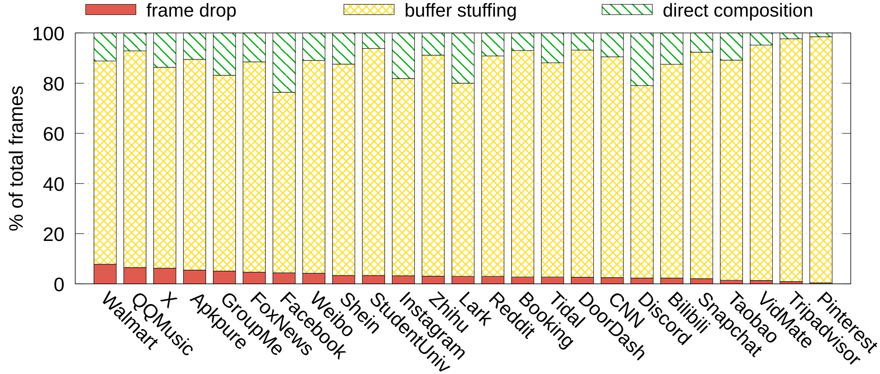
Rendering Latency due to Buffer Stuffing
Most frames (85%) get stuffed into the buffer queue rather than being directly displayed due to frequent frame drops, creating unnecessary latency.
The rendering latency is about three times of the VSync period: 45.8ms, 32.2ms, and 24.2ms for Pixel 5 (60Hz), Mate 40 Pro (90Hz), and Mate 60 Pro (120Hz).
Notes:
Due to frequent frame drops, more than 85% of the frames experience such unnecessary latency.
And the rendering latency is about three times of the VSync period.

Slide 15
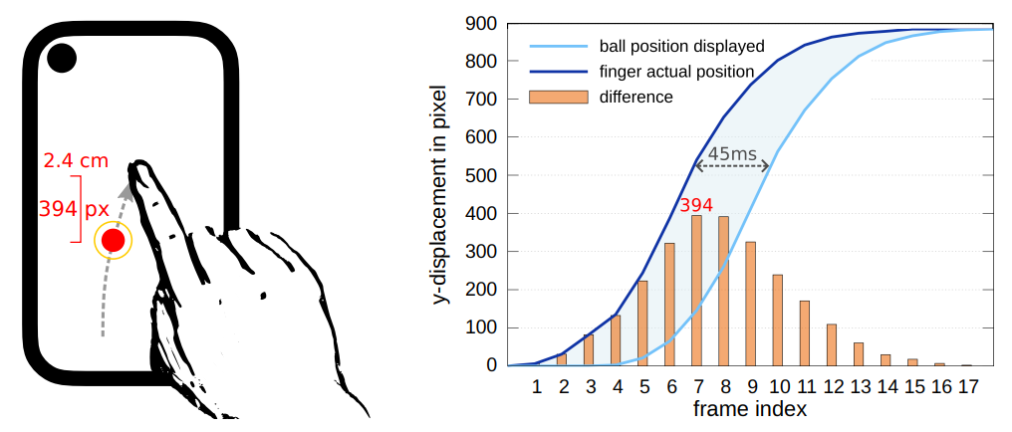
Visualization of Rendering Latency
To visualize the consequence of rendering latency, we write an app that simply draws a red ball at the position of the touch event.
As we swipe the finger upwards, we can clearly see that the ball falls behind. When the rendering latency is 45ms, the maximum position difference from the fingertip to the ball reaches around 400 pixels (2.4cm) as we swipe fast.
Notes:
To visualize the consequence, we write an app that simply draws a red ball at the position of the touch event.
As we swipe the finger upwards, we can clearly see that the ball falls behind our fingertip for at most 2 centimeters, not being fully covered by the fingertip.

Slide 16
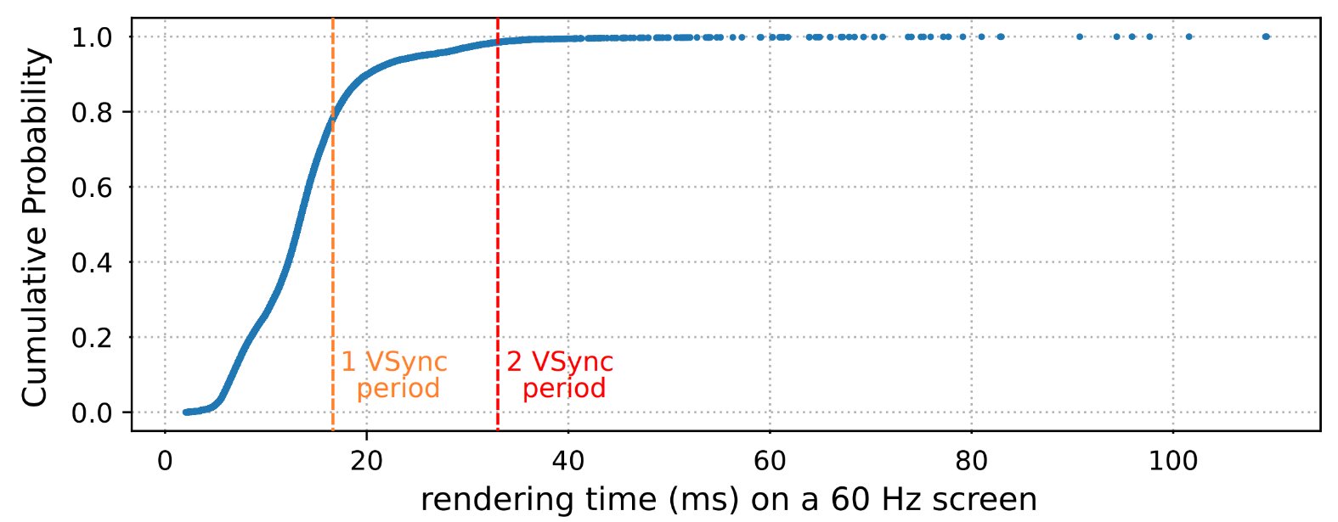
Observation: The Power Law Distribution of Rendering
Workload fluctuation is an inherent characteristic of rendering, with a majority (≥95%) of the frames being short and quick, and a small portion (≤5%) of the (key) frames being heavily loaded that cause frame drops and ultimately degrade the user experience.
Notes:
To sum up, workload fluctuation is an inherent characteristic of rendering that causes frame drops and buffer stuffing.
Through analyzing the rendering time of all the frame traces we collected, we discovered the power law distribution of rendering.
That is, a majority of the frames are short and quick that finish in time, while less than 5 percent of the frames are heavily loaded that cause frame drops and ultimately degrade the user experience.

Slide 17
Insight: Frame Rendering Time Reallocation
If it is possible to utilize the computational power saved by common short frames to provide a larger time window for executing long frames, …
App UI Thread
Frame 3
Frame 4
Frame 5
Frame 6
… …
Rendering Service
Frame 2
Frame 3
Frame 4
Frame 5
Frame 6
… …
deadline miss
Screen Displaying
Frame 1
Frame 2
Frame 3
JANK
Frame 4
Frame 5
Frame 6
VSync Signals
timeline
Notes:
From the trace, we can see that Frame 4 is heavily loaded and causes stutters, while frame 2 and 3 are light-weight and have idle CPU time at the end of their VSync periods.
If it is possible to utilize the computational power saved by these common short frames to provide a larger time window for executing the later long frame, then …

Slide 18
Insight: Frame Rendering Time Reallocation
…, then we will be able to eliminate the jank and have a perfectly smooth screen updating with no stutters.
App UI Thread
Frame 3
Frame 4
Frame 5
Frame 6
… …
Rendering Service
Frame 2
Frame 3
Frame 4
Frame 5
Frame 6
… …
catch the deadline
Screen Displaying
Frame 1
Frame 2
Frame 3
Frame 4
Frame 5
Frame 6
VSync Signals
timeline
Notes:
we will be able to let the frame 4 catch the deadline, eliminate the jank, and have a perfectly smooth screen updating with no stutters

Slide 19
Decoupling Rendering and Displaying
Current rendering services assume that the content to be rendered corresponds to the present moment in time.
  Thus, the rendering execution must be placed just before the frame displays to avoid any lag, leaving it a very short time window to finish.
Our key insight is to break the assumption:
  A frame can be rendered much earlier under possible and deterministic conditions such as animations and simple interactions.
  The buffer queue can hold more than three buffers, so that if a long frame runs longer than expected, the screen is still able to consume the pre-rendered short frames in the buffer queue.
  Decouple the time that the rendering workload executes and the time that the rendering frame represents.
Notes:
Current rendering services assume that the content to be rendered corresponds to the present moment in time.
Thus, the rendering execution must be placed just before the frame displays to avoid any lag, leaving it a very short time window to finish.
And our key insight is to break the assumption, so frames can be rendered much earlier under possible and deterministic conditions such as animations and simple interactions.
When a long frame runs longer than expected, the screen is still able to consume the pre-rendered frames in the buffer queue.
In other words, we would like to decouple the time that the rendering workload executes and the time that the rendering frame represents.

Slide 20
Challenges of the Decoupling
First, the decoupling must explicitly manage the execution of individual frames when pre-rendering is feasible under possible and deterministic scenarios.
Second, when rendering ahead, the decoupling needs to guarantee that the rendering frame content remains correct, as it would under VSync architectures.
Last, the decoupling should be extensible and compatible with diverse interactive scenarios and custom-rendering applications (e.g., games or browsers).

Slide 21
D-VSync:
Decoupled Vertical Synchronization
Notes:
To this end, we introduce D-VSync, Decoupled Vertical Synchronization.

Slide 22


OS Rendering Architecture (Data Path)
Input Event
App
UI logic
queue
Draw Commands
OS RS
animation
queue
Frame Buffers
Screen HAL
Let’s revisit the data path of the 3-stage OS rendering architecture.
Notes:
Let’s revisit the 3-stage OS rendering architecture.

Slide 23
VSync Rendering Architecture (Control Path)
Input Event
Request
Next Frame
Frame Timing Manager
App
Post Events with Timestamps
UI logic
VSync Event
Timestamp
queue
Draw Commands
Request
Next Frame
VSync
OS RS
animation
VSync Event
Timestamp
queue
Frame Buffers
HW-VSync Model
Screen HAL
HW-VSync Signal
Each stage sends requests to the Frame Timing Manager (FTM) for VSync signals in each frame to execute the next frame. FTM posts periodic VSync events with wall-clock timestamps for animation rendering at a frequency (e.g., 120Hz).
Notes:
App processes and the rendering service both send requests to the Frame Timing Manager for VSync events in each frame to execute the next frame.
In the VSync architecture, these events posted by the Frame Timing Manager are just periodic VSync events with the current wall-clock timestamp for animation rendering.
This is the traditional VSync control path.

Slide 24
D-VSync Rendering Architecture (Control Path)
Input Event
Input Prediction
Request
Next Frame
Frame Timing Manager
App
Post Events with Timestamps
UI logic
(D-)VSync Event
(D-)Timestamp
queue
D-VSync
Draw Commands
Frame Pre-Executor
Request
Next Frame
VSync
OS RS
Display Time Virtualizer
animation
(D-)VSync Event
(D-)Timestamp
Runtime Controller & API
queue
Frame Buffers
HW-VSync Model
Screen HAL
HW-VSync Signal
The decoupled pre-rendering includes a Frame Pre-Executor (FPE), a Display Time Virtualizer (DTV), a Runtime Controller & APIs for input prediction and custom-rendering applications. Also, the queues now contain more than 3 buffers.
Notes:
For D-VSync, however, the control path is comprised of a Frame Pre-Executor (FPE in short), a Display Time Virtualizer (DTV in short), and extension APIs.
Also, the queues now can contain more than 3 buffers to hold pre-rendered frames.

Slide 25
D-VSync Key Module: Frame Pre-Executor
Frame Pre-Executor (FPE) explicitly controls the timing and pacing of frame executions with D-VSync events posted prior to the display VSyncs when deterministic scenarios make pre-rendering feasible.
In the VSync baseline, each frame is triggered by the VSync signal.
requestNextFrame()
Rendering Service
Frame i
Frame i+1
Frame i+2
VSync
triggered
deadline miss
VSync Signals
timeline
VSync Baseline
Notes:
The first key module is the Frame Pre-executor.
It explicitly controls the timing and pacing of frame executions with D-VSync events posted to app processes and rendering service prior to the screen VSyncs when deterministic scenarios make pre-rendering feasible.
Here, this diagram shows the VSync baseline, each frame is triggered only by the periodic VSync signals.

Slide 26
D-VSync Key Module: Frame Pre-Executor
In D-VSync, app UI framework or rendering service mark the frames when decoupled pre-rendering is feasible (page transition animation, list flinging animation, etc.) through a decouple parameter.
Virtual D-VSync event triggers frame pre-execution for accumulation.
requestNextFrame(decouple = true)
Rendering Service
Frame i
Frame i+1
Frame i+2
D-VSync
triggered
catch the deadline
VSync Signals
timeline
D-VSync Accumulation Stage
Notes:
However, in D-VSync, the app UI framework or the rendering service will first mark the frames when decoupled pre-rendering is favored, during animations such as page transition frames after a click, or list flinging frames after a swipe, etc., through a parameter named decouple.
Then the frame pre-executor will send virtual D-VSync events to pre-execute these frames without waiting, and the rendered frames will be accumulated in the enlarged buffer queue for the screen to display.
Here, the green frame catches the deadline.

Slide 27
D-VSync Key Module: Frame Pre-Executor
FPE explicitly manages frame executions. When the accumulation
ends, frames are realigned with VSyncs.
Pre-rendering reaches a configured maximum
External inputs or events make pre-rendering infeasible
requestNextFrame(decouple = true)
Rendering Service
Frame i
Frame i+1
Frame i+2
Frame i+3
Frame i+4
D-VSync
triggered
VSync
triggered
VSync Signals
timeline
D-VSync Sync Stage
Notes:
When the accumulation ends, specifically, the pre-rendering reaches a configured maximum that uses up the queue buffers, or external inputs or events make pre-rendering not possible,
Then the frames will be realigned or synced with the VSync signals, until another long frame lets the screen empty the buffer queue and triggers the accumulation again.

Slide 28




D-VSync Key Module: Display Time Virtualizer
Display Time Virtualizer (DTV) provides a new abstraction of frame display timestamp to the app UI framework or rendering service, ensuring content correctness of pre-rendered frames.
In VSync architecture, the VSync timestamp T is used for animation.
Ti
Ti+1
Ti+2
Rendering Service
Frame i
Frame i+1
Frame i+2
deadline miss
VSync Signals
timeline
VSync Timestamp in Baseline
Notes:
Another key module of D-VSync is the display time virtualizer.
DTV ensures content correctness of the pre-rendered frames.
Here, in the illustrated VSync baseline, each frame just uses the VSync Timestamp, namely the current wall-clock, for animation.

Slide 29
D-VSync Key Module: Display Time Virtualizer
In D-VSync, DTV virtualizes the future display time of the frame from the current execution time of the code, providing the new Display-Timestamp abstraction, T , for sampling animations.
D
D
D
D
Ti
Ti+1
Ti+2
=
=
=
Ti
Ti+1
Ti+2
Rendering Service
Frame i
Frame i+1
Frame i+2
catch the deadline
VSync Signals
timeline
D-VSync Display Timestamp
Notes:
However, in D-VSync, as frames may get pre-executed, simply using the current wall clock does not suffice.
The DTV module virtualizes the future display time of the frame from the current execution time of the code, providing the new Display-Timestamp abstraction, TD,
to the app processes and rendering service to sample the animations and do the rendering.
TD guarantees that animations never appear fast in accumulation or slow down in long frames, with a uniform pacing just as the fixed VSync rhythm.

Slide 30
D-VSync APIs and Extensible Modules
Dual-channel decoupling APIs for compatibility:
  Decoupling-oblivious channel:
    System animations and app UI animations.
    No app source code modification is needed.
    Default performance improvements!
  Decoupling-aware channel:
    Predictive curve fitting for pre-rendering real-time interactive frames.
    For custom-rendering apps, such as games, Flutter apps, web apps.
    Configure D-VSync parameters and receive D-VSync events!
Notes:
We also propose dual-channel decoupling APIs: so D-VSync brings default improvements directly to decoupling-oblivious app binaries for system animations and OS UI Framework animations.
On the other hand, decoupling-aware apps modified in source code can have specialized enhancements for interactive frames or custom rendering applications, such as game UIs, Flutter apps, or web apps. Please see our paper for the case studies.

Slide 31
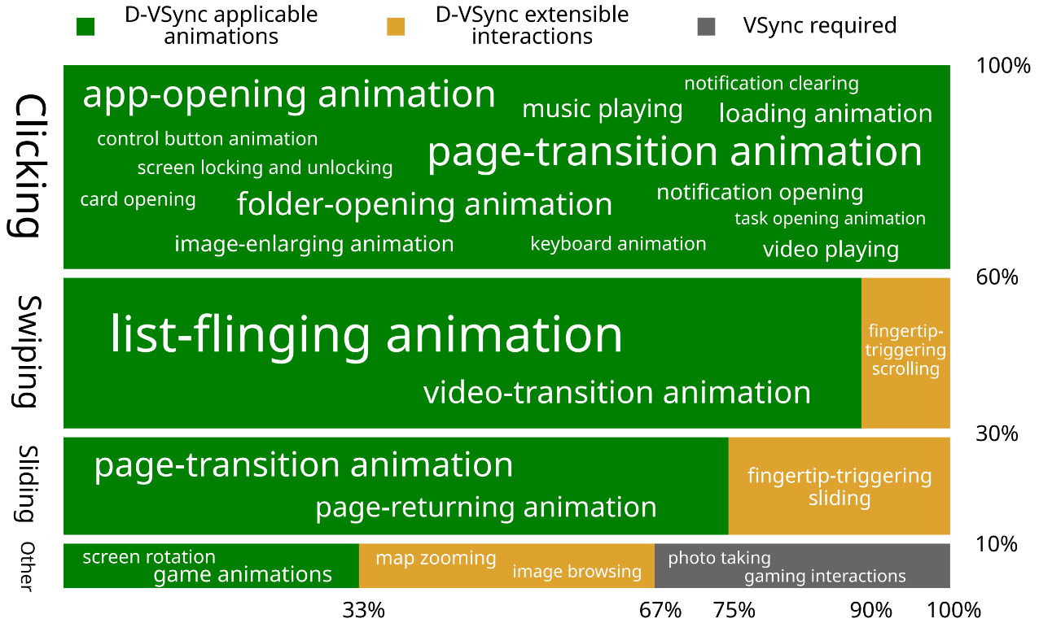
Application Scope of D-VSync
D-VSync is applicable to deterministic animation frames (85%), and extensible to pre-renderable interactions/custom-rendering apps (10%).
Notes:
By default, D-VSync is applicable to deterministic animation frames that occupy 85% of the total frames, such as page-transition, app-opening, notification clearing, list flinging, etc.
Another 10% of the frames are pre-renderable using the extension APIs.

Slide 32
The Co-design of D-VSync with LTPO
LTPO targets at lowering power consumption. VSync frequency can be lowered in real time when the motion of animations is slow enough for human eyes to perceive any difference.
D-VSync targets at reducing frame drops and enhancing smoothness.
The co-design of D-VSync and LTPO:
  Ensuring consistent rendering and displaying. Frames rendered at 𝑋 Hz are not displayed at 𝑌 Hz.
  Coordinating the timing of rendering rate change and refresh rate change in terms of accumulated frames if any.
  Each rendered frame buffer has a rendering rate bound to it, deciding its display duration.
Notes:
D-VSync is also compatible with the state-of-the-art LTPO dynamic refresh rate solutions.
Please see our paper for the detailed co-design and implementation.

Slide 33
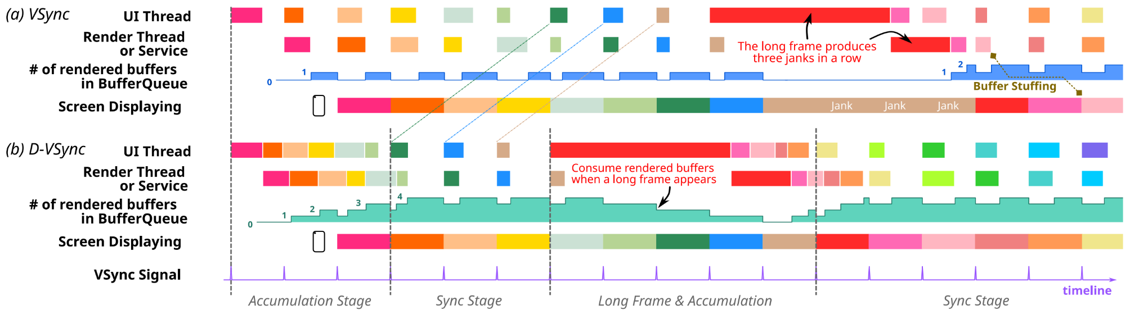
A Running Example of D-VSync
For the exactly same series of workloads, the VSync architecture produces three janks in a row, creating stutters and degrading user experience, while the D-VSync is perfectly smooth.
Notes:
Here is a running example of D-VSync with a buffer queue of size 5.
For the exactly same series of workloads, the VSync architecture produces three janks in a row due to the heavily-loaded red frame, while D-VSync is perfectly smooth.
When a long frame appears, the screen can consume rendered frame buffers accumulated in the queue.

Slide 34
Evaluation
Notes:
Finally, the evaluation

Slide 35
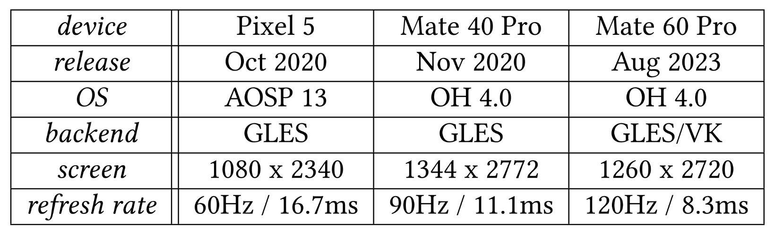
Experiment Configurations
We implement and evaluate D-VSync on Google Pixel 5 (60 Hz) with AOSP 13, and Mate 40 Pro (90 Hz) and Mate 60 Pro (120 Hz) with OH 4.0. We report both the objective data of frame drops, and the subjective data of stutters.
Notes:
We implement and evaluate D-VSync on Google Pixel 5 with AOSP 13,
and Mate 40 Pro and Mate 60 Pro with OH 4.0.
We report both the objective data of frame drops, and the subjective data of stutters.

Slide 36
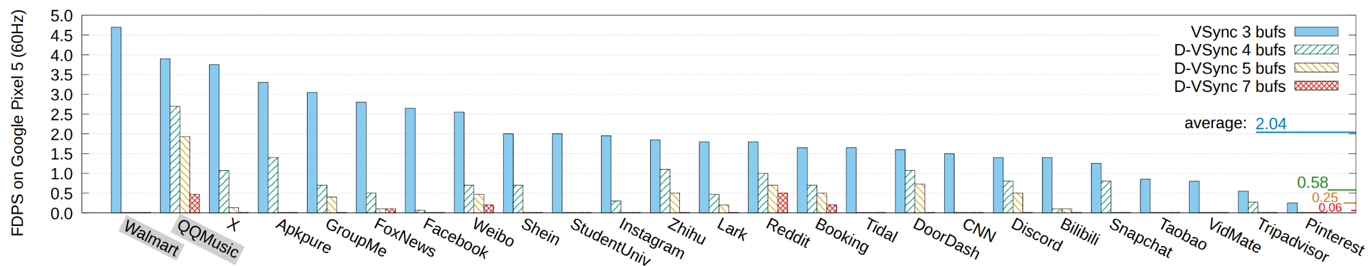
Objective Frame Drop Reduction
For 25 world top apps on Pixel 5, VSync has frame drops per second (FDPS) of 2.04, while D-VSync with 4 buffers has 0.58 FDPS (71.6% ) and D-VSync with 5 buffers has 0.25 FDPS (87.7% ). More frame drops are eliminated as D-VSync more proactively renders frames.
Notes:
For 25 world top apps on Pixel 5, VSync with triple buffering, the baseline, has frame drops per second of 2.04.
D-VSync with 4 buffers, that is, able to pre-render at most two frames ahead, reduces 71.6% of frame drops,
and D-VSync with 5 buffers reduces 87.7%. More frame drops are eliminated as D-VSync more proactively renders frames with a large buffer queue.

Slide 37
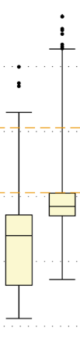
Objective Frame Drop Reduction
App-Q
App-W
For App-W, frame drops are scattered in time, while App-Q has a skewed distribution, with long frames that even 7 buffers fail to hide the jank.
D-VSync is not a panacea, and inefficient code is still discouraged.
VSync
period
8
4
2
1
0.5
0.25
App-Q
App-W
Notes:
Here, we compare App-W and App-Q, where D-VSync significantly improves the former, not the latter. For App-W, frame drops are scattered in time and most long frames take less than 3 VSync periods, as shown by the frame rendering time boxplot.
In contrast, App-Q has a considerably skewed distribution, with numerous long frames that even 7 buffers fail to hide the jank.
Therefore, inefficient code is still discouraged.

Slide 38
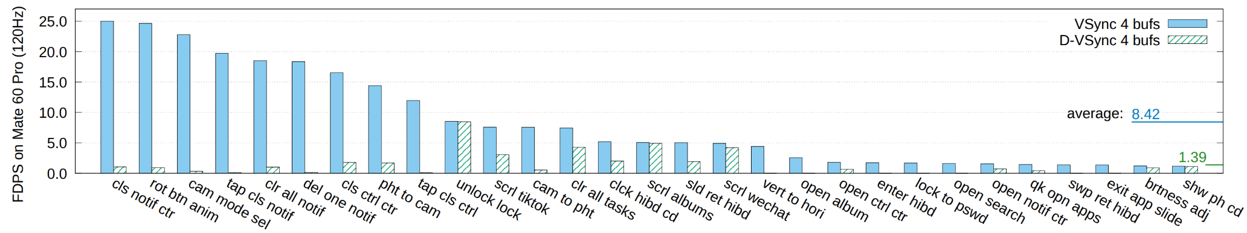
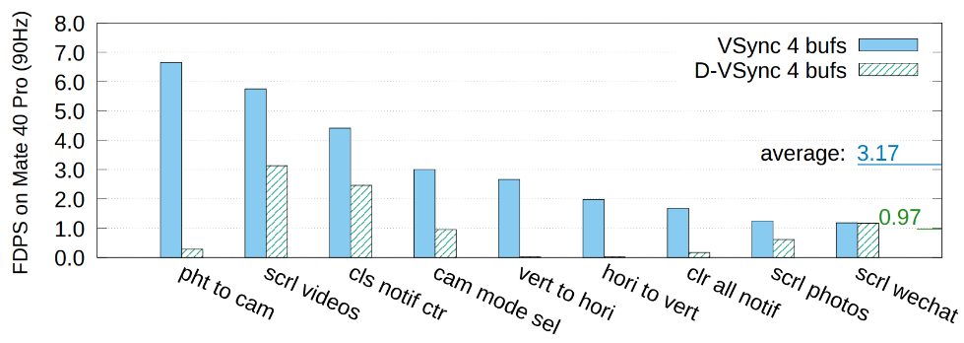
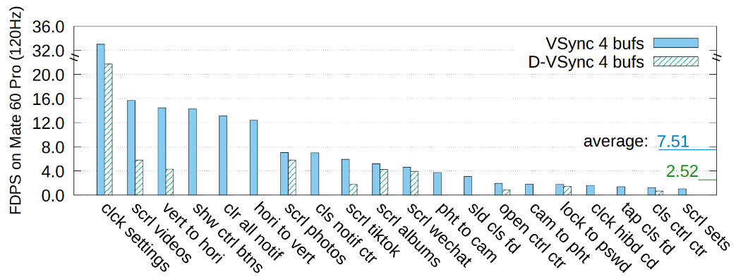
Objective Frame Drop Reduction
We also evaluate 75 common OS use cases on Mate 40 Pro and Mate 60 Pro, the average frame drop reduction with D-VSync equipped is 72.7% .
Notes:
We also evaluate 75 common OS use cases on Mate 40 Pro and Mate 60 Pro with GLES and Vulkan backends, the average frame drop reduction with D-VSync equipped is 72.7%. The use cases are listed in the paper appendix.

Slide 39
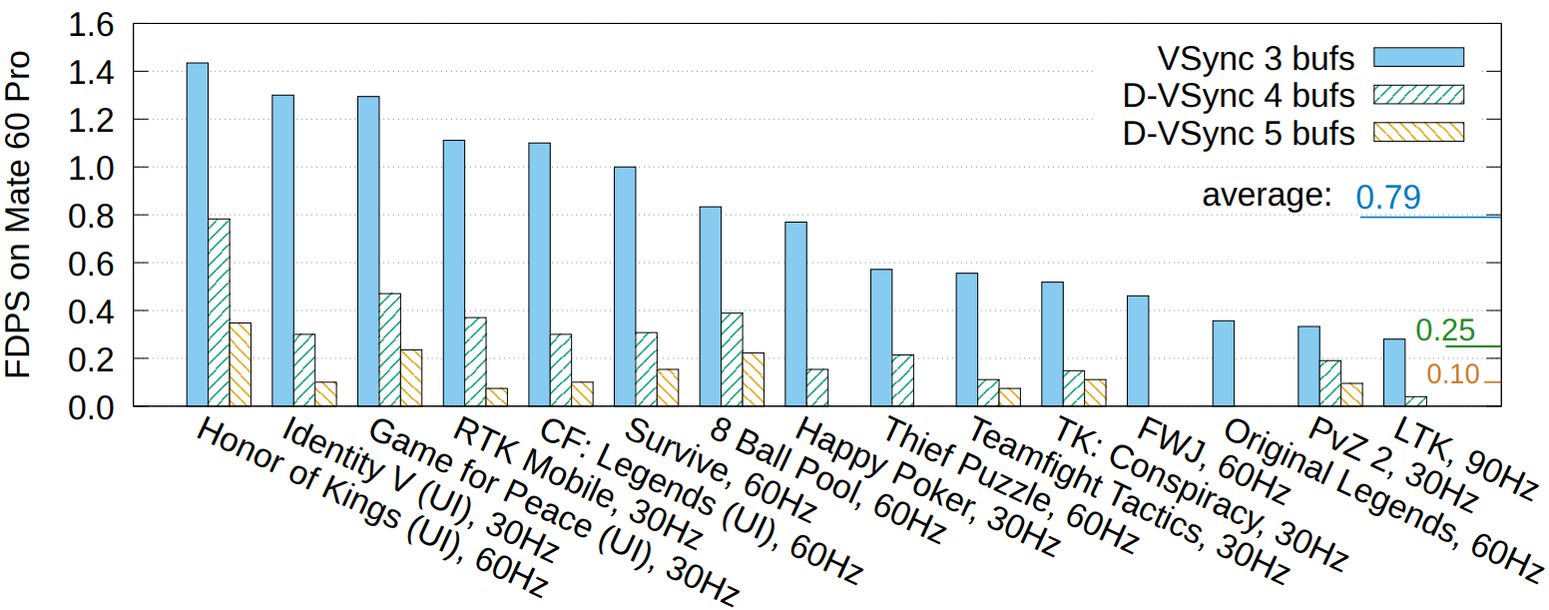
Objective Frame Drop Reduction
For D-VSync simulation on game runtime traces, D-VSync can have a theoretical 68.4% frame drop reduction with 4 buffers in the queue.
Notes:
In addition, we collect the runtime traces of 15 mobile games for UI and scene animations when pre-rendering is possible. We then use scripts to simulate the D-VSync decoupled pre-rendering pattern and count frame drops. D-VSync can have a theoretical 68.4% frame drop reduction with 4 buffers in the queue.

Slide 40
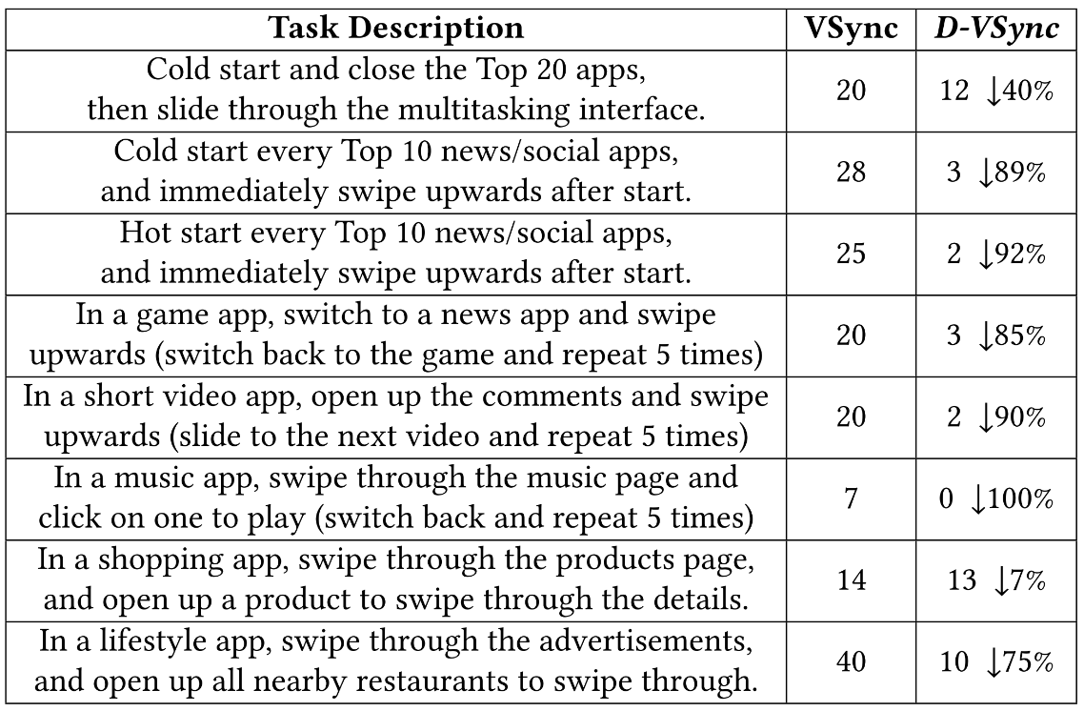
Subjective Stutter Reduction
Professional user experience evaluators are instructed to perform the listed tasks.
Each task is comprised of multiple operations on multiple pages to simulate real-world behaviors.
D-VSync on average reduces 72.3% of the stutters.
Notes:
For subjective stutter reduction, we have professional user experience evaluators to perform the listed tasks, each of which is comprised of multiple operations on multiple pages,
such as cold start and close the top 20 apps, then slide through the multitasking interface, to simulate real-world user behaviors.
D-VSync on average reduces 72.3% of the stutters.

Slide 41
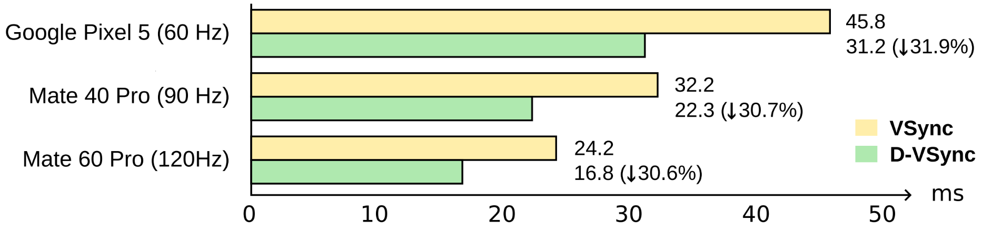
Rendering Latency Reduction
D-VSync circumvents the unnecessary waiting latency caused by buffer stuffing in the triple-buffering VSync architecture.
With decoupled Display-Timestamp, D-VSync can proactively pre-render future frames with no time discrepancy.
On average, D-VSync reduces the rendering latency by 31.1% .
Notes:
With decoupled Display-Timestamp, D-VSync can proactively pre-render future frames with no time discrepancy.
Thus, through circumventing the unnecessary waiting caused by buffer stuffing, D-VSync reduces the rendering latency by 31.1%.

Slide 42
Costs of D-VSync
Execution Time: the pre-execution management and the display time computation spends an additional 102.6 µs of execution time every frame. However, D-VSync thread is on little cores.
Memory: each additional frame buffer takes around 10 MB in Pixel 5 and 15 MB in Mate phones.
Device Power consumption: increases 0.13%-0.37%, including the rendering of frames that would have been dropped in VSync.
CPU Instruction Count: the averages are 10.849 and 10.793 million instructions per frame with D-VSync on and off. The additional overhead is 0.52%.
Notes:
D-VSync has costs.
The pre-execution management and the display time computation spends 102.6 microseconds of execution time every frame.
// However, the D-VSync thread is on little cores, not competing with app or rendering on medium or big cores.
For memory, each additional frame buffer takes 10 to 15 megabytes.
The device power consumption is increased by 0.13%-0.37%. This includes the rendering of frames that would have been dropped in VSync.
For CPU instruction count, the additional overhead is 0.52% per frame.

Slide 43
Deployment Experience
Subjective data are equally important, particularly for rendering systems interacting with end users.
Educating application and system developers is crucial, especially for the deployment of a new architecture.
Compatibility should be considered in advance, when different related solutions are being developed in parallel.
Notes:
Finally, we derived three lessons from our deployment of D-VSync.
First, subjective data are equally important, particularly for rendering systems interacting with end users.
Second, educating application and system developers is crucial for the deployment of a new architecture, which alters the traditional execution pattern and traces.
Last, compatibility should be considered in advance, such as the LTPO dynamic refresh rates and D-VSync, which is discussed in our paper.

Slide 44

Conclusion
D-VSync, a new rendering architecture for smartphone Oses, has been integrated into HarmonyOS NEXT.
Based on the power law distribution of rendering, D-VSync decouples the rendering and displaying.
Occasional long frames can use the computational power saved by common short frames for a larger time window to tolerate workload fluctuations.
D-VSync
Video Demo
https://www.youtube.com/watch?v=GvQvPZZet2g
Thanks!
Notes:
In conclusion, we introduce Decoupled Vertical Synchronization, a new rendering architecture for smartphone operating systems. D-VSync has been integrated into HarmonyOS NEXT as a key feature for smoothness.
Based on the power law distribution of rendering, D-VSync decouples the rendering and the displaying,
so, occasional long frames can use the computational power saved by common short frames for a larger time window to tolerate workload fluctuations.
You can scan the QR code to see the D-VSync video demo.
Thank you all and I would like to take questions.

